Slide 1




CrowdPay
CROWDPAY
A FinTech Revolution
01
project abstract

Slide 2

Presentation Overview
CrowdPay
How CrowdPay is different from other systems.
How it works
Key-Players involved.
UI
Data Model
Areas of Improvement
Problem Statement
Existing systems & its problems.
Solutions to existing systems
Existing PeerToPeer systems.
Success stories.
CrowdPay
02
project overview

Slide 3
Problem
Statement
CrowdPay
The rate of unemployement in Indian, during the months of April and May this year was an unprecidented 23.52%. The roots of which can be directly linked to the COVID-19 pandemic and the ensuing public lockdown, with a large population of our citizens finding it difficult to make ends meet. Recent reports suggest that the Unorganized Sector which was worst hit will atleast take 2-3 years to break even.
With our country set to regain its past glory, our prime attention should be to rehabilitate both the Rural and Unorganized Sector of our country.
Helping these sectors stabilize would mean more and more job oppurtunities which in turn would vitalize our economy. But to begin with, finding the capital investment for the underprivileged is almost a herculean task; nipping out all thei dreams and desires.
What can we do to help them succeed?
03
problem statement

Slide 4
Existing Platforms
To Avail A Loan
CrowdPay
OFFICIAL FINANCIAL INSTITUTIONS
MONEYLENDERS
FRIENDS & FAMILY
The most common option for getting funding is through a loan given by banks as well as other official financial institutions.Nowdays getting a loan is not very easy due to financial economic crisis.
A moneylending loan is a short-term and high cost form of loan . Using a moneylender is one of the most expensive ways you can
borrow money.
Borrowing from friends & family is a popular resort when they fail to secure a loan due to a bad credit score, previous unpaid loans, or any other reason.
04
existing banking institutions

Slide 5
Hurdles All The Way
CrowdPay
01
02
03
04
05
COLLATERAL
INDENTIFICATION
BUSINESS
PLAN
DETAILED
DEMOSTRATION
ASSET
REVIEW
DEBT
HISTORY
10
09
08
07
06
JURY
REVIEW
EMI
ASSESSMENT
INSURANCE / CREDIT CARD INFORMATION
COMPLETE FINANCIAL ASSESSMENT
ALMOST THERE
05
hurdles in availing a business loan

Slide 6
That's Too
Much Effort
CrowdPay
To avail a business loan in these traditional institutions you'll have to go through a hectic process - wait for a minimum of 3 weeks, plus the extra effort in documentation, verification and even then you have not much hope of finally getting it. This is if you have a collateral, but can the underprivileged afford to wait 3 more weeks with no collateral and no one to stand in as guarantee.
06
problems with these traditional models

Slide 7
An Easier Life
One Click Away
CrowdPay
The above problems create a need for a financial revolution
Peer To Peer (P2P)
Lending
Peer-to-peer lending is a form of direct lending of money to individuals or businesses without an official financial institution participating as an intermediary in the deal. P2P lending is generally done through online platforms that match lenders with the potential borrowers.
07
PITCH DECK V 1.0
problems with these traditional models

Slide 8

CROWDPAY
Our Idea is to create an online peer-to-peer lending platform which enables borrowers to access affordable fixed-rate, fixed-term unsecured personal loans between Rs.1,000 to 50,000. Investors have the opportunity to earn solid returns via traditional state agencies doubling in as underwriters. The borrowers will be classified based on various aspect like health status, occupation, life style, financial risk factor into minimal, low, medium, high, very high, unrated risk categories.
CrowdPay
08
crowdpay-a new step

Slide 9
P2P In India
3
CrowdPay
The Indian P2P post RBI regulation in 2015, lending market is estimated to reach $4 Bn-$5 Bn valuation by 2023. Overall, a BCG report has predicted the digital lending industry to touch $1 Tn mark in the next five years. Some of the prominent players in the Indian market include LenDenClub, Faircent, RupeeCircle, LoanBaba, CapZest, and i2iFunding.
2
1
0
2015
2016
2017
2018
2019
p2p valuation in billions
09
p2p in india

Slide 10



Market
Leaders
RupeeCircle is the new age Peer-to-Peer (P2P) lending company backed by Mahindra Finance and Oracle’s Cloud Accelerator Program, they aim to drive financial inclusion to millions of unbanked & under-banked creditworthy borrowers in India.
CrowdPay
Faircent is India's first peer-to-peer lending platform with RBI certification, providing a marketplace that connects individuals in need for credit with individuals and institutes willing
to lend their access funds.
A novel P2P lending and borrowing platform in India.It allows individuals to get fast personal loans or become lender to earn higher interest on their savings. The platform helps lenders to multiply their money faster.
10
market leaders

Slide 11
So What's New
About CrowdPay?
CrowdPay
Unlike any existing p2p lending model, CrowdPay aims to unite the efforts of our state government in funding these new entrepreneurs. Here only members of any one of the 49 state agencies would be able to sign in as a borrower, with the state agency doubling in as the underwriter. The State agency will stand as guarentee for the borrower, and will be held responsibe for the money if the borrower fails to return the credit.
For this the state agency will receive a commission of 1% of the total credit, thus create a healthy and investment safe formulae for success.
11
so what's new about CrowdPay

Slide 12
Who Are The
Key Players?
CrowdPay
BORROWER
STATE AGENCY
INVESTOR/LENDER
Someone who's in need for money
One of the 49 State Agency listed under Kerala State Governmnet
Anyone, anywhere from the world who's willing to invest money.
12
who are the key players

Slide 13
How CrowdPay
Works
01
02
CrowdPay
CHECK
ELIGIBILITY
REGISTER
CrowdPay follows an easy and transparent 6 step loan avail process
03
04
MEMBERSHIP
VERIFICATION
CHECK EMI
RATES
05
06
13
LOAN
REQUEST
ACCEPTED
DONE
how crowdpay works

Slide 14
Steps Detailed
CrowdPay
REGISTER
CHECK ELIGIBILITY
MEMBERSHIP VERIFICATION
CHECK EMI RATES
LOAN REQUEST ACCEPTED
Register to get a personal loan for your financial goals. A personal loan through p2p lending can help you take control of
your finances.
Tell us about yourself and
how much
credit you want to consolidate.
We
will notify you once your mentioned State Agency have confirmed the
membership.
Review your monthly payment and then choose the consolidation
loan option you like best.
Once your loan request is approved, you are provided with lender details and loan is automatically
deposited into your bank account.
14
steps detailed

Slide 15
STEPS TO
Make Your Money
Work For You
FOLLOW
CrowdPay
If you are someone who is looking to make a quick buck over the stagnant cash you have with you, then this is for you. We are providing you an opportunity to be part of a social cause,which enables millions of unemployed in India to start their own business with the money you lend.
REGISTER WITH KYC NUMBER
FIND LOAN TICKETS
CHECK INTEREST RATES
TRANSFER AMOUNT
.
15
make money work for you

Slide 16
User Interface
Even though envisioned as a complete web application with mobile support, only the a mobile application was developed due to deadline contraints. We hope to build upon this later on.
The mobile application was developed using Flutter SDK and during developement Google Firebase was used for authentication, cloud notification and storage.
CrowdPay
16
user interface

Slide 17
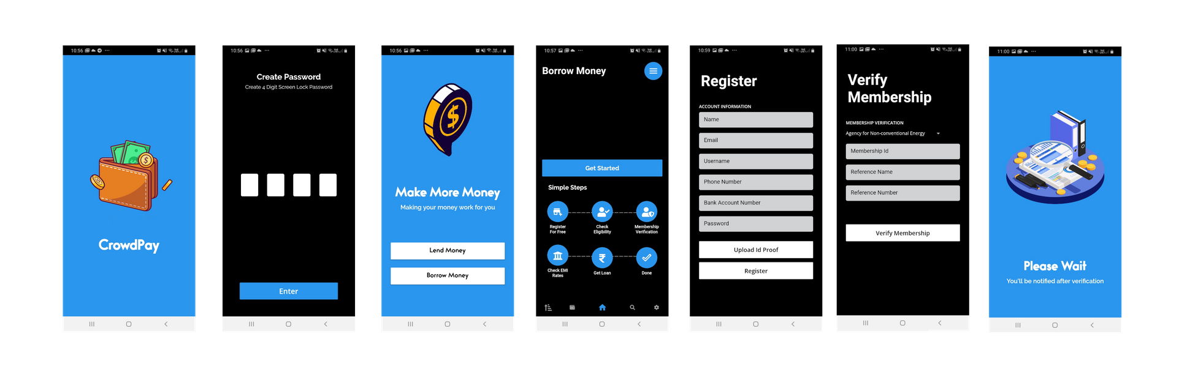
User Interface
CrowdPay
Borrower UI
17
user interface

Slide 18
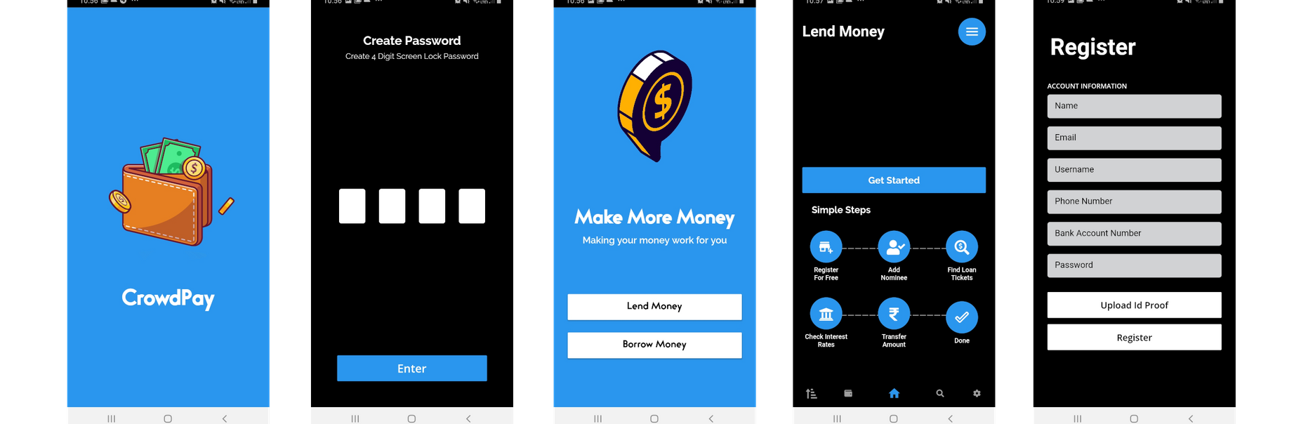
User Interface
Lender UI
CrowdPay
18
user interface

Slide 19
Data Model
BORROWER
LOAN_REQUEST
credit_id(PK)
borrower_id(FK)
loan_amt
loan_tenure
interest_rate
risk_rating
ability to repay
CrowdPay
borrower_id(PK)
fname
lname
current_address
permanent_address
kyc_complete
highest qualification
EMPLOYMENT DETAILS
STATE_AGENCY_INFO
id(PK)
profession_type
employment_desc
borrower_id(FK)
id(PK)
member_from
member_till
borrower_id(FK)
id(PK)
asset_type
asset_value
credit_id(FK)
id(PK)
existing_liability
liability_type
credit_id(FK)
19
BORROWER ASSET
BORROWER LIABILITY
data model

Slide 20
Data Model
INVESTER
NOMINEE
id(PK)
fname
lname
tax_id
contact_number
kyc_complete
investment_limit
fund_committed
INVESTOR PROPOSAL
id(PK)
invester_id(FK)
fname
lname
dob
reln_with_invester
id(PK)
invester_id(FK)
loan_ticket_id(FK)
proposal_amt
proposal_date
last_update_date
CrowdPay
PAYMENT_METHOD
ACCOUNT STATEMENT
CREDIT FULFILMENT
id(PK)
invester_id(FK)
account_type_code(FK)
accunt_number
account_type
account_holder_name
bank_name
id(PK)
invester_id(FK)
transaction_type_code((FK)
transaction_amt
transaction_date
closing_balance
id (PK)
invester_proposal_id (FK)
release_date_from_invester
disburse_date_to_borrow
emi_amt
emi_start_date
emi_end_date
num_of_total_emi
id(PK)
credit_fulfilment_id(FK)
emi_due_date
due_interest_amt
due_principal_amt
due_emi_amt
penality_amt
emi_amt_received
penality_amt_received
code(PK)
account_type_desc
code(PK)
transaction_type
CREDIT REPAYMENT
ACCOUNT_TYPE
20
TRANSACTION TYPE
data model

Slide 21
How we can further improve?
CrowdPay
Using AI & ML we can categorize the borrowers into the different risk levels.
Also we could use NLP techniques to make sure the lender & borrower details are genuine.
At a later stage, using Blockchain, we can create a secure payment gateway integration, which is not currently included.
21
how can we further improve

Slide 22
CrowdPay
Thank You!
22
thank you

